Slide 1

Abstraction, Binding and SCOPE
Learn it like never before

Slide 2


What is in a name?
Name: Yaali
Alice & Bob
Relating to or denoting art that does not attempt to represent external reality, but rather seeks to achieve its effect using shapes, colours, and textures.

Slide 3
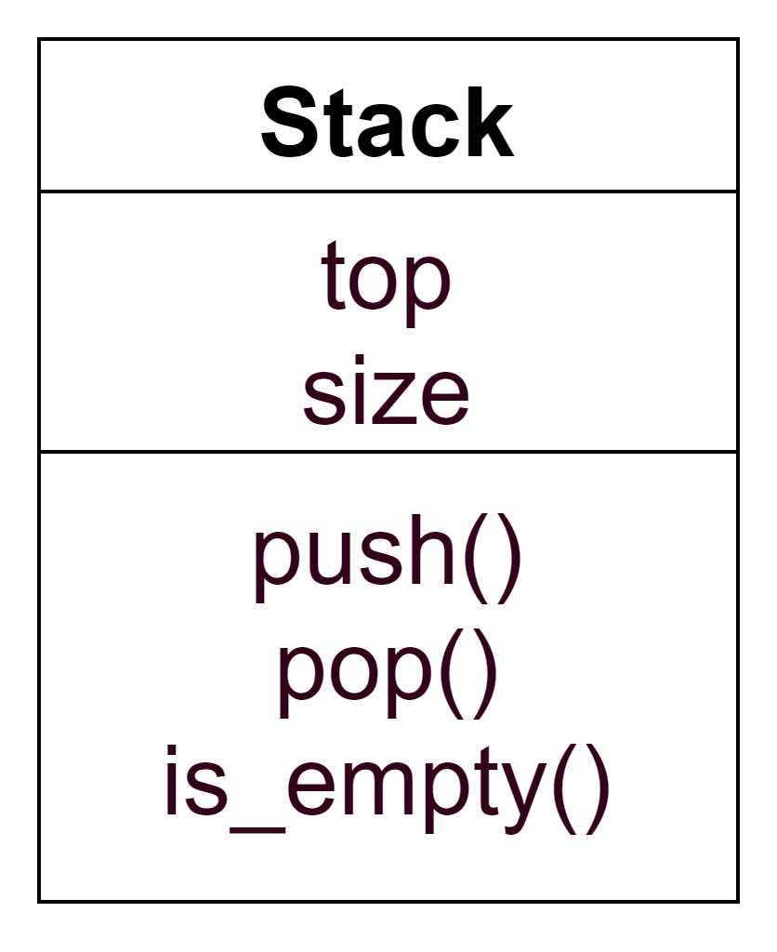


Complexity simplified

Slide 4
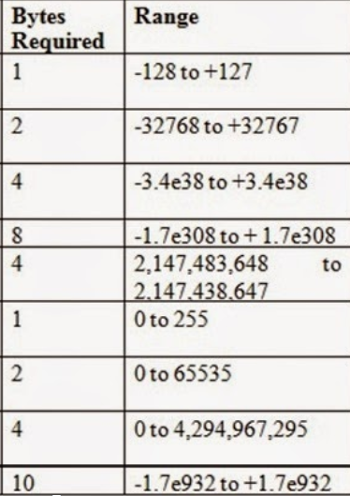
And Abstraction Begins

Slide 5
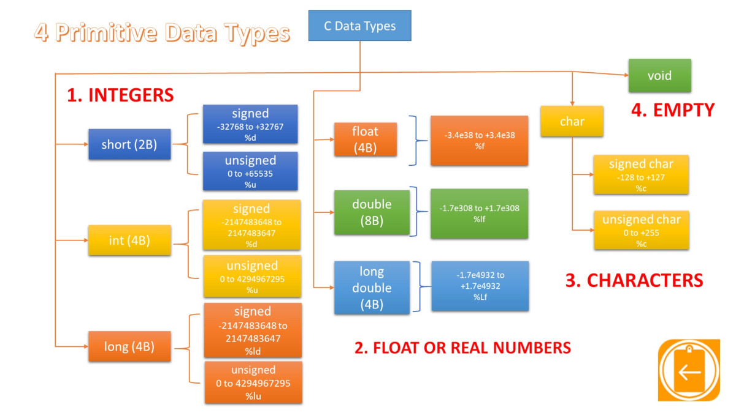
Colourful Abstraction

Slide 6
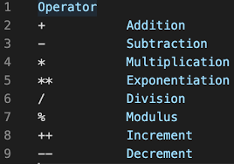
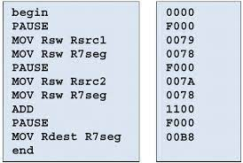


You know this already
Name is mnemonic character string used to represent something else.
Arithmetic operators are abstract types.
So as is your High Level Language is abstracted from several internals:
Notes:
Variable names, operator names ( +, -, =, *, etc) are the abstraction of something else, that is some operation it is intended to live for.
Separated from the details of any particular computer architecture.
Separated from the complex assembly instructions, registries.
Easy to read and understand.

Slide 7
What else is an abstraction in programming?
Function/Method
Pointers
Structure/Class
Ex: Print/Printf/cout/Println are abstracted several details and you just use it when you need it.

Slide 8
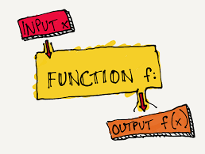
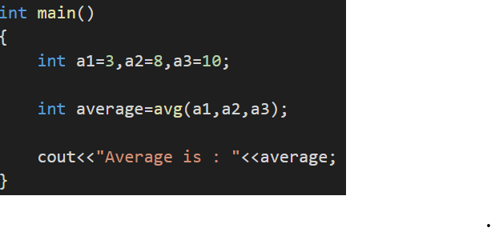
function/method

Slide 9
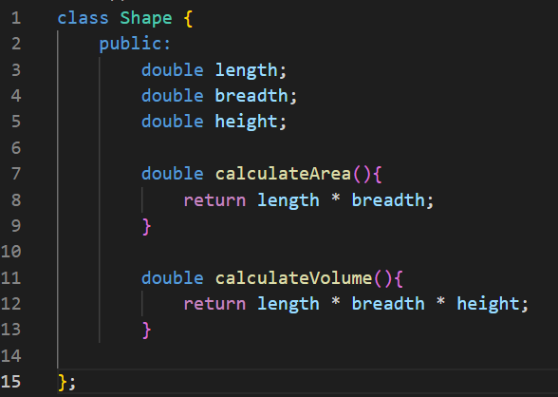
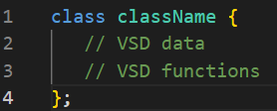
CLASS - An abstract data type

Slide 10
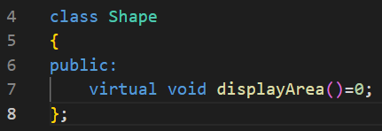
Abstract class is different from abstract data type

Slide 11
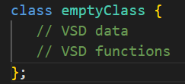
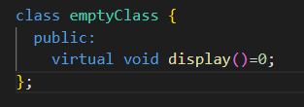
Interview questions
Q. What is the size of an empty class in C++?
Q. What is the size of an abstract class?

Slide 12
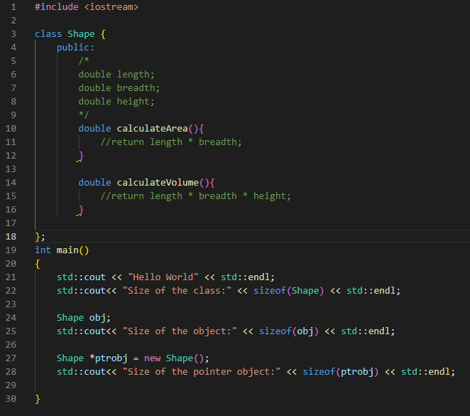
Interview questions
Q. What is the size of the class,
the object and
pointerobject?

Slide 13
Interview questions
Q. Do you consider Arrays, Lists, Maps, Trees, and Priority Queues as ADTs?
Q. When does the binding happens to the abstract data type?
Compile Time
Linking Time
Load Time
Run Time

Slide 14

What is binding?
When do you bind,
how long the binding lives and
who is aware of this binding?

Slide 15
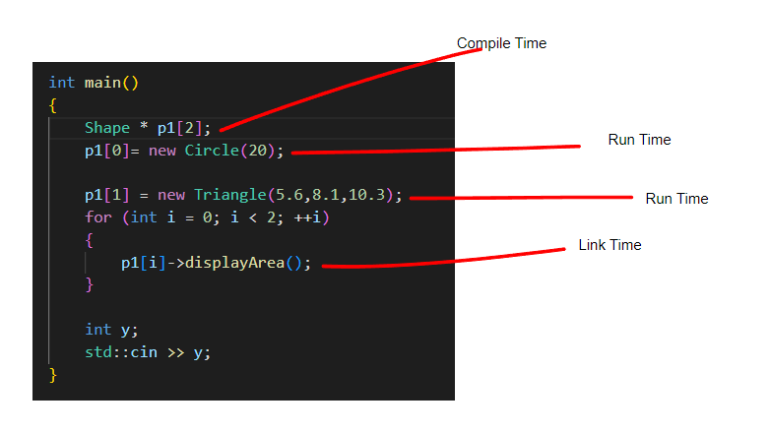
Binding Time

Slide 16

scope
How long the data can be lived?
Who can access your data?
Global
Namespace
Local
Function
Class
Notes:
Global scope
Local scope
Namespace scope
Class scope
Statement scope
Function scope
Function parameter scope
Enumeration scope
Template parameter scope

Slide 17
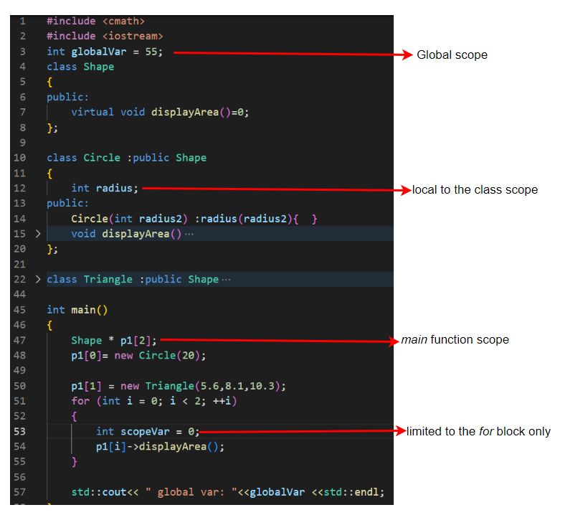
Expand your scope of understanding

Slide 18
Interview questions
Why should you have scope to the data?
How is global and static different?
namespace scope - when do you prefer to use it?
When do you use scope resolution :: operator?
How do you differentiate between lifetime and scope of variables?

Slide 19

Object lifetime
Static
Stack
Heap
Notes:
Object lifetimes generally correspond to one of three principal storage allocation mechanisms, used to manage the object’s space:

Slide 20
Object lifetime
Creation and destruction of objects
Creation and destruction of bindings
Deactivation and reactivation of bindings that may be temporarily unusable
References to variables, subroutines, types, and so on, all of which use bindings
Notes:
The period of time between the creation and the destruction of a name-to object binding is called the binding’s lifetime. Similarly, the time between the creation and destruction of an object is the object’s lifetime.

Slide 21
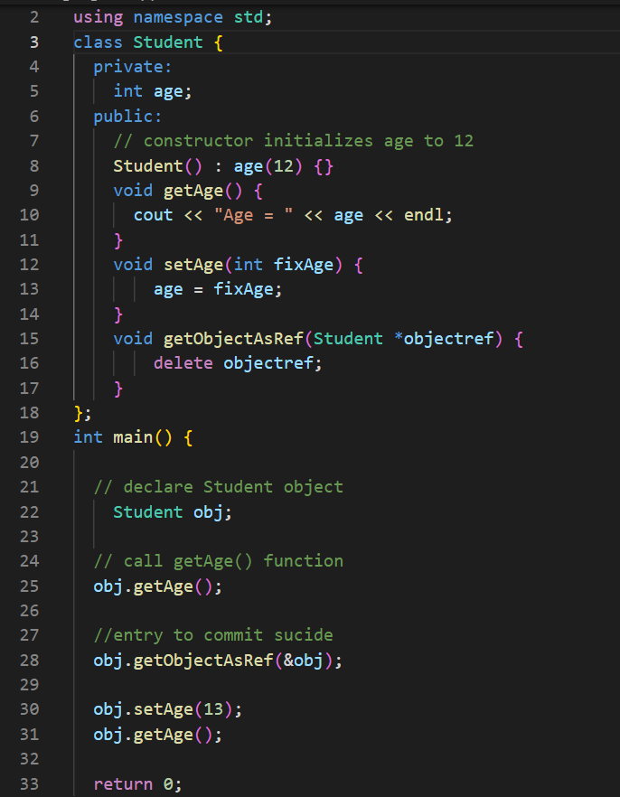
Spot a bug
name-to-object binding to have a lifetime longer than that of the object

Slide 22
Storage management
Static allocation
Stack allocation
Heap allocation

Slide 23

Static allocation
Determined at compile time
Global variables
Program’s machine code
String literals

Slide 24
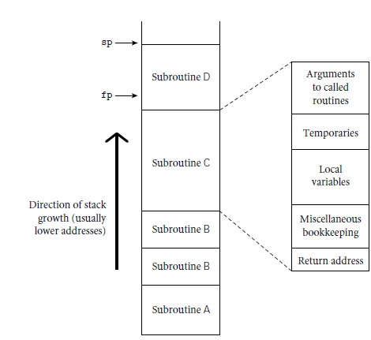
Stack allocation
Each instance of a function at run time has its own frame on the stack, containing:
arguments,
return values,
local variables,
temporaries, and
bookkeeping information.
Stack frame
Notes:
Temporaries are typically intermediate values produced in complex calculations
Bookkeeping information typically includes the subroutine’s return address, a reference to the stack frame of the caller (also called the dynamic link), saved values of registers needed by both the caller and the callee
Arguments to be passed to subsequent routines lie at the top of the frame,
While the location of a stack frame cannot be predicted at compile time (the compiler cannot in general tell what other frames may already be on the stack), the offsets of objects within a frame usually can be statically determined. Moreover, the compiler can arrange (in the calling sequence or prologue) for a particular register, known as the frame pointer to always point to a known location within the frame of the current subroutine.

Slide 25

Heap allocation
A heap is a region of storage in which subblocks can be allocated and deallocated at arbitrary times.

Slide 26

Garbage collection
garbage collection mechanism to identify and reclaim unreachable objects.

Slide 27
Interview questions
What is binding time?
Advantages of early binding and late bindings?
What determines whether an object is allocated statically, on the stack, or in the heap?
What do you commonly find in a stack frame?
What is a frame pointer? What is it used for?
What is a dangling reference?
What is garbage collection?

Slide 28


Subscribe and comment

